Slide 1
**PLEASE NOTE**
You have clicked present. Now when you move on to the next slide the animations will automatically happen at the beginning. When you are done reading you can change the slide and the process will repeat.
Thank you!
Please Enjoy!

Slide 2




Slide 3
Table of Contents
Industry
Products
Location of Store
Employees
Target Market
Competition
Business Strategy
Expansion
The Numbers
Click the following to quickly go to any slide you prefer. If you want you can continue in order just change this slide.

Slide 4
Industry:
The industry I am in is one of the hottest industries in the world. It is an industry everyone loves. The food and restaurant industry. After a long day people love to eat nice delicious food. But it must be something they enjoy. We are going to make that delicious enjoyable food which will bring us to the top of this industry.

Slide 5
Products
Pakistani/Indian dishes:
Briyani
Nihari
Haleem and Hareesa
Halwa Puri
Naan and Kabob
Pulao
Chicken Karahi
Chicken tikka
Dhal with chawaal or roti
Pakora
Shawarma
Drinks:
Lassi
Chai
Milkshakes
Coffee
Rabri Doodh
Pop
Roohafza
Sweet Dishes:
Icecream
Cake
Rasmalai
Mithai/sweets

Slide 6

Location of my Restaurant
The location of my restaurant will be at the major intersection of Yonge & Dundas. Located in the heart of downtown Toronto. Directly facing the Eaton Center which is the biggest shopping district in the city. Giving us the advantage of having a wide range of customers. Furthermore, when people go shopping they tend to always crave something doesn't matter if it's a small bite or for dinner. People always want to eat and we will be there giving them excellent service.

Slide 7
Number of Employees I will Hire
At the beginning I am to hire a minimum of three employees. One clerk, one server and one chef. As my progress will continue and I gain a substantial amount of customers I will hire more employees. I believe quality beats quantity. It does not matter if I have 20 employees working at my restaurant and they cannot deliver good service then what is the point of having them. That is why I choose to have fewer employees for now and to soon train many others to join us and become the best of the best.

Slide 8
The Target Market
Our target is to serve people and families of all ages and kinds, the delicious foods of our culture. My restaurant will be open to all, so people from all age groups, income levels and education can come in and enjoy. Our main customers will most likely be South Asian people (Pakistani Indian, etc). We will welcome all who want to enjoy the great foods our culture offers.

Slide 9
Main Local Competition
Biryani House, Buffet Palace and King Place Restaurant are the three main restaurants near me. They are my biggest competitors. I have been in these restaurants before. At the Biryani House I ate one of their biryanis for $14.95. The briyani was barely worth the price! So how does the business run if it cannot produce the quality? They are all the same so the people are forced to go with one or the other. My biryani costs $12.95 and is a thousand times tasteful compared to that joke of a briyani. The people now have a choice to leave those places and come to a place that is very passionate for their satisfaction.

Slide 10
My Business Strategy
I have been in many restaurants over the years. Most of them have two things in common, they do not care about the quality of the food and the customer service is awful. Therefore my business strategy is self explanatory. Make delicious high quality food for reasonable prices and have amazing customer service so everyone can eat and enjoy. In return I will gain repeating customers which will not only generate skyrocketing profits but will make your investment the best you have ever made.This ideology gives me the utmost confidence that my business will run in a brilliant fashion and is the best strategy for any successful business owner!

Slide 11
The Great Expansion
!
!
Due to my amazing business strategies in different sectors I am fully confident that my business will grow. The quality of food is at its finest, the prices are affordable for all income levels and the customer service is awesome. Which leads to only one major upgrade. Opening multiple stores. By the end of my first year I will open my second location. But why stop at one location when you can expand throughout the city. Then again why stop at just one city when you can move to other cities and then provinces and finally the whole country.

Slide 12
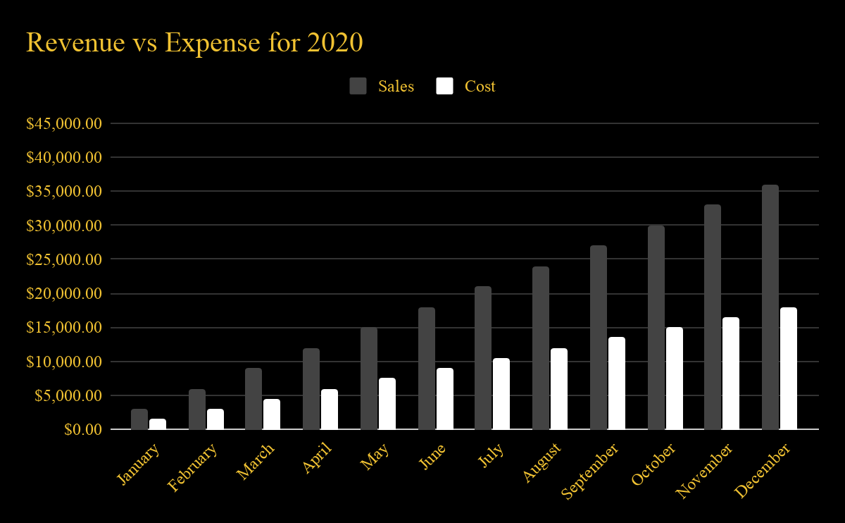
Sales vs Costs for 2020
Total Revenue = $234,000

